Slide 1
Document Question Answering
Interview Project

Slide 2
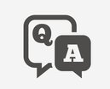
Document Question Answering
DER: An AI tool that can visually understand the information on a document image and respond to the question at hand.
ROI: Making extracted document content useful in high-level tasks defined by the human consumers of this information.
Data needed
Synthetic doctor notes.
Generic real-word forms.
Technology
Optical character recognition (OCR).
LLMs.
Deliverable: Web App with UI
ETA: 2 Days

Slide 3
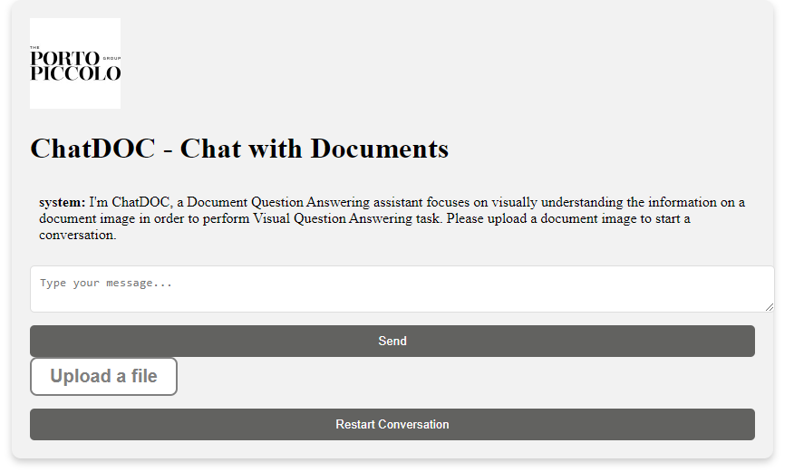
User Interface
The user interface is built mainly by Flask. It has the abilities to:
Chat with a GPT
Upload the file and ask the GPT with relative questions
Restart the conversation

Slide 4
Optical Character Recognition (OCR)
Upon file upload, the application utilizes Optical Character Recognition (OCR) technology to extract text from the uploaded documents. This process involves scanning the document image, recognizing the characters, and converting them into machine-encoded text.

Slide 5
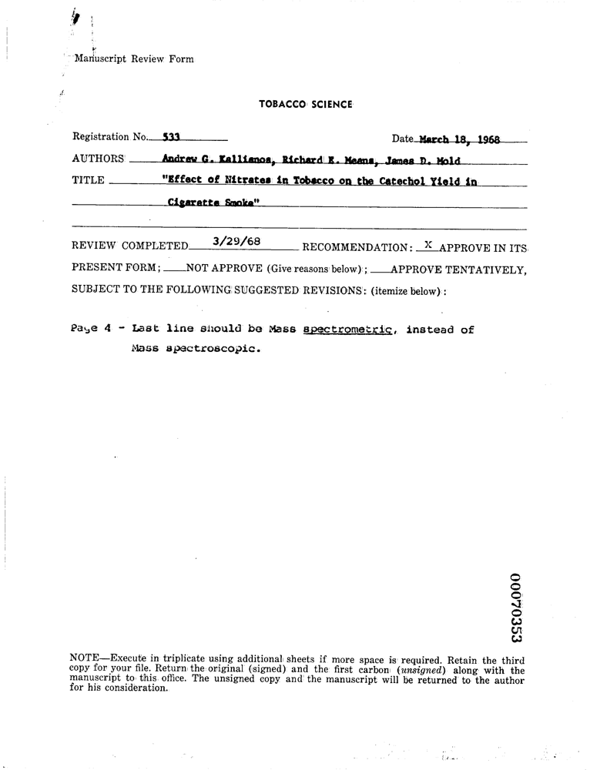
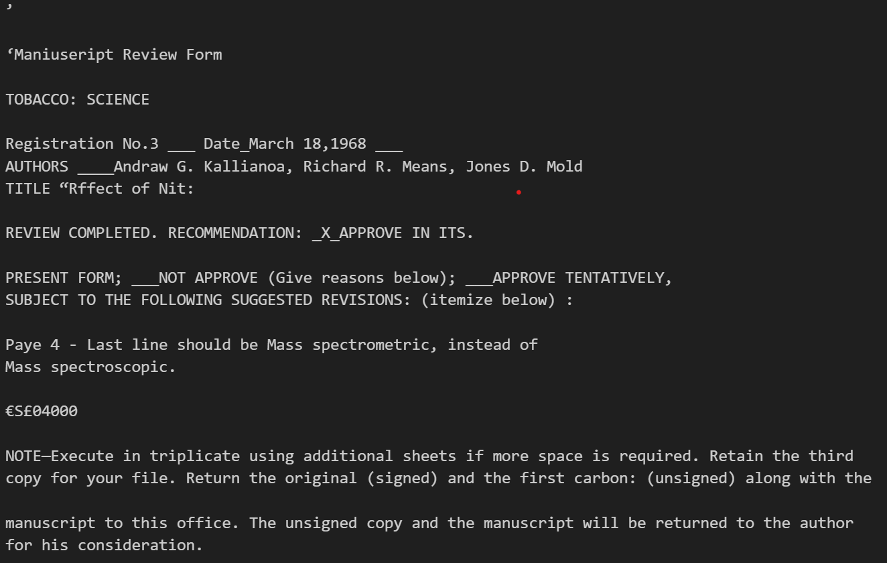
Optical Character Recognition (OCR)

Slide 6
GPT API
Understand and analyze the extracted text and the user's question.
Utilizing natural language processing (NLP) and machine learning algorithms, the chat model generates contextually relevant answers.
responsible for the intelligent interaction, providing users with informative and accurate answers based on the content of their uploaded files.

Slide 7
Further Steps
The model has not been fine-tuned for specific types of Data
The current output does not effectively represent non-text elements like marks, tick boxes, separators, and diagrams, nor does it accurately capture the document's layout, including page structure, forms, and tables, or style elements such as font, colors, and highlighting.

